Slide 1
Software Testing Methodologies
Prashant Joshi

Slide 2
Module 4: Agenda
Module 4: Specification Based Testing – (2/2)
Topic 4.1
Domain Testing
Topic 4.2
Combinatorial
Topic 4.3
Decision Table Based Testing
Topic 4.4
Examples & Case Study

Slide 3
Topic 4.1: Domain Testing

Slide 4
The Concept
A black box test technique
Based on specifications
Independent of implementation
Focus
Functional testing
Behaviour
Input & corresponding output
x
P
(Square
of number)
x²
Implementation may be,
Multiplication (x*x)
successive addition (x+x… x times)

Slide 5
Approaches & “View”
Purpose is to uncover defects
Demonstrate the system works (Treat this as a by-product!)
Validate that it functions per specifications
Works as specified – always!

Slide 6
Perspectives
Customer/Client
Alpha/Beta User
End User/Consumer
Development Engineer
Architect
Product Manager
Maintenance Engineer
…

Slide 7
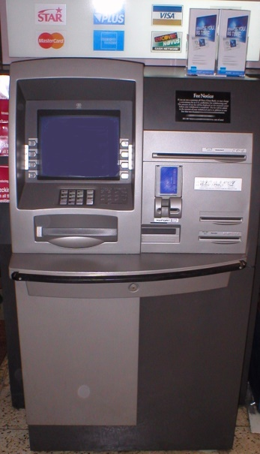
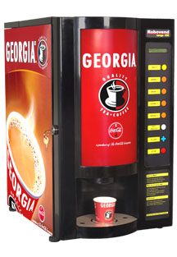
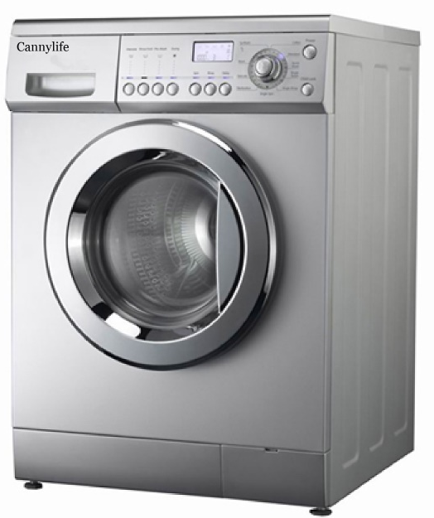
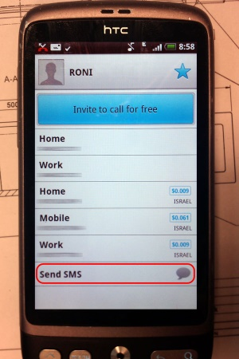
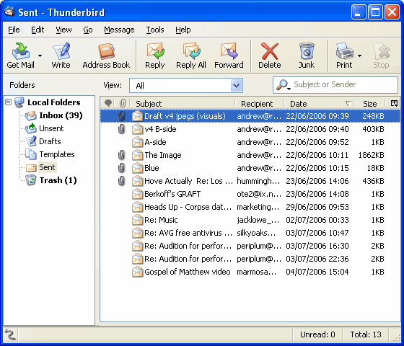
Examples
Automated Teller Machine
Tea/Coffee Vending Machine
Washing Machine
Contacts – Mobile Phone Application
Messaging – Mobile Phone Application
Email – Webmail/App/Client
…

Slide 8
What is it?
It is a systematisation of the Equivalence Partitioning and Boundary Value Analysis
Introduces concept of Test Specification which allows the test engineer to take a closer look at the specifications
Allows division of tasks for larger systems

Slide 9
Category Partitioning Method
Systematic approach to generation of test cases from requirements
Mix of manual and automated steps
Ref: T2 Chapter 3 Section 3.5

Slide 10
CP Method Steps
Analyse Specification
Identify Categories
Partition Categories
Identify Constraints
(Re) write test specification
Process specification
Evaluate generator output
Generate test scripts

Slide 11
1: Analyse Specification
Identify the functional unit that can be tested separately
For larger systems, break down into subsystems, that can be tested independently

Slide 12
2: Identify Categories
For each testable unit, analyse the specification and isolate inputs
Identify objects in the environment
Determine characteristics (category) of each parameter and environment object
Explicit characteristics
Implicit characteristics

Slide 13
3: Partition Categories
Identify cases against which the functional unit must be tested (cases = choices)
Partition categories into at least two subsets – correct values and incorrect values
Valid subdomain
Invalid subdomain

Slide 14
4: Identify Constraints
Test for functional unit consists of a combination of choices for (a) parameter and (b) environment object
Identify possible and not-possible combinations
Thus, specify the constraints

Slide 15
5: (Re) write test specification
Based on previous steps a test specification can now be written
Write the complete test specification
Make use of a TSL which can help automate the process

Slide 16
6: Process Specification
TSL or test specification is used to generate test frames
Test frames are not test cases

Slide 17
7: Evaluate Generator Output
Examine test frames for redundancy or missing cases
Iterative process and steps

Slide 18
8: Generate Test Scripts
Generate test cases from test frames
Generate test scripts from test cases; typically a group of test cases

Slide 19
Software Testing Methodologies
Prashant Joshi

Slide 20
Topic 4.2: Combinatorial

Slide 21
Need of Combinatorial
Software to be test in various environments
Various combination factors
Need for combinations of inputs
Application
High Reliability needs
Work on various configurations (Windows, Mac, Linux)
Interoperability
Various Clients & Servers (MMS)

Slide 22
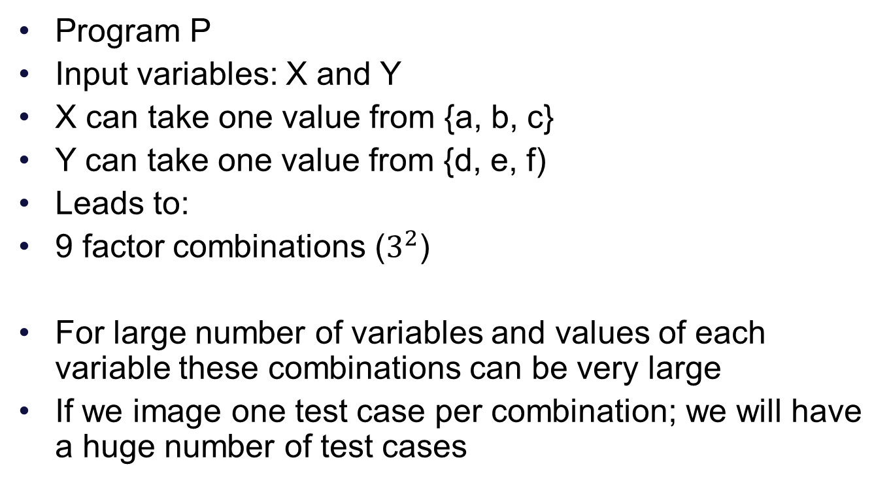
Modelling The Input
Program P
Input variables: X and Y
X can take one value from {a, b, c}
Y can take one value from {d, e, f)
Leads to:
9 factor combinations ($3^{2}$)
For large number of variables and values of each variable these combinations can be very large
If we image one test case per combination; we will have a huge number of test cases

Slide 23
Model the input
Fault Model (Interaction Faults)
Two or more variables play a role
One or more specific values play a role
Unique combinations
Latin Squares
Pairwise Testing
Orthogonal Array
In this module we focus on the use of combinatorial alone; Focus on the reduction and specific techniques for optimization will be discussed in later Module

Slide 24
Software Testing Methodologies
Prashant Joshi

Slide 25
Topic 4.3: Decision Table Based Testing

Slide 26
Decision Tables
One of the most systematic approaches of designing Test Cases
Decision Tables are rigorous – enforce logical rigor
Related Method – Cause Effect Graphing
Ideal for situations with number of combinations of actions are taken under varying sets of condition
Structure of describing rules
Steps
Specifications
Decision Table
Test Cases

Slide 27
DT Technique
T: True
F: False
---: Don’t Care
<blank>: Not applicable
X: Action takes place
Notion of completeness
N conditions ➔ 2^{N} rules
Actions can be defined by user

Slide 28
DT - Example
Component Specification: Input of 2 characters such that
The 1st character must be A or B.
The 2nd character must be a digit.
If the 1st character is A or B and the 2nd character is a digit the file is updated.
If the 1st character is incorrect, message X12 is displayed.
If the 2nd character is not a digit, message X13 is displayed.
Develop test cases using Decision table technique

Slide 29
DT Example Solution
Note that it may not be possible to execute or even design test cases for the impossible action rule. But to begin with never ignore these conditions. Design them and then evaluate if they can be included in the Test Suite.

Slide 30
Software Testing Methodologies
Prashant Joshi

Slide 31
Topic 4.4: Examples & Case Study

Slide 32
Test Techniques
Equivalence Class
Boundary Value Analysis
Domain Partitioning
Combinatorial
Decision Table

Slide 33
Examples – Solve them
TV Remote Control Software
Software is designed for the remote control which has typical controls and options. Using DT design and develop test cases
A web based shopping cart checkout logic
By number of items
By weight of items
By value of items

Slide 34
Examples – Solve them
An insurance renewal premium
By Age
By Number of claims
By Value of claims
Folder and File Name generation for a Digital Camera
Use of a Serial number
Use of Date
Use of Date+time

Slide 35
Browsers on Operating Systems
Browsers (Firefox, Chrome, Safari and MyBrowser) are to be tested on various operating systems (Windows, Linux) and on various platforms like PC, Mobile. On Mobile phones the operating systems to be considered are (iOS, WP8, Android)
Come up with a strategy and test cases

Slide 36
School Attendance System
An attendance sub-system is developed which is part of a School Management System. At the beginning of the year the Class teacher creates the roster for the class by pulling in the details from Master Data Base. The fields that teacher uses are Full Name and Class/Division. Over that she builds a local database with entry of Nickname, Months of attendance, Attendance, Reasons for absence in case of absence (Sick, Informed Leave, School program, Competitions). Following reports are generated at the end of the week:
Classes attendance report
Student attendance report
Absenteeism report
Student absenteeism report
Design a set of test cases to test such a sub-system

Slide 37
Software Testing Methodologies
Prashant Joshi

